Slide 1
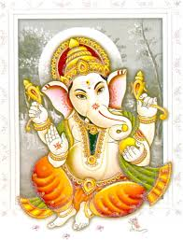
Good morning

Slide 2
Previous class
Machine Learning-Intro.
Designing a Learning system.
Version space.
Issues in ML.

Slide 3
Today’s class
Linear Algebra.
Calculus.
Probability.
Gaussian distribution.
Decision Theory.
Information theory.
Entropy.

Slide 4
Good morning

Slide 5
Linear Algebra
Modeling
Spaces
Maps
Matrices and vectors
System of simultaneous equations

Slide 6
Linear Algebra
Nodal Incidence Matrix.
The network in picture consists of six branches (connections) and four nodes (points where two or more branches come together).
One node is the reference node (grounded node, whose voltage is zero). We number the other nodes and number and direct the branches. This we do arbitrarily. The network can now be described by a matrix. A is called the nodal incidence matrix of the network.

Slide 7
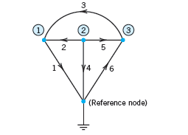
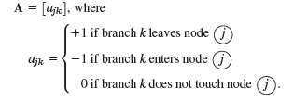
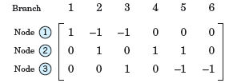
Linear Algebra
Nodal Incidence Matrix.

Slide 8
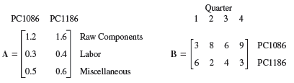
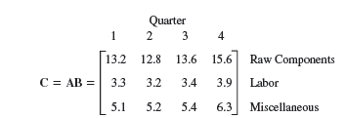
Linear Algebra
Matrix Multiplication-Example.
Supercomp Ltd produces two computer models PC1086 and PC1186. The matrix A shows the cost per computer(in thousands of dollars) and B the production figures for the year 2010 (in multiples of 10,000 units.) Find a matrix C that shows the shareholders the cost per quarter (in millions of dollars) for raw material, labor, and miscellaneous.
.

Slide 9
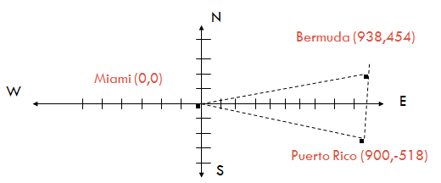
Linear Algebra
The Bermuda Triangle is a large triangluar region in the Atlantic ocean. Many ships and airplanes have been lost in this region. The triangle is formed by imaginary lines connecting Bermuda, Puerto Rico, and Miami, Florida. Use a determinant to estimate the area of the Bermuda Triangle.

Slide 10
Linear Algebra
The Bermuda Triangle
The approximate coordinates of the Bermuda Triangle’s three vertices are: (938,454), (900,-518), and (0,0). So the area of the region is as follows

Slide 11
Linear Algebra-Cramer’s rule
The atomic weights of three compounds are shown. Use a linear system and Cramer’s rule to find the atomic weights of carbon(C ), hydrogen(H), and oxygen(O).
Compound | Formula | Atomic weight
Methane | CH₄ | 16
Glycerol | C₃H₈O₃ | 92
Water | H₂O | 18

Slide 12
Linear Algebra-Cramer’s rule
The atomic weights of three compounds
are shown. Use a linear system and
Cramer’s rule to find the atomic
weights of carbon(C ), hydrogen(H),
and oxygen(O).

Slide 13
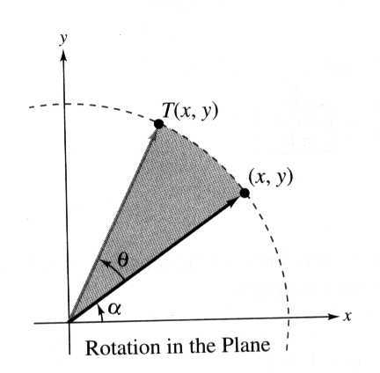
Ex : Rotation in the plane
given by the matrix
has the property that it rotates every vector in R² counterclockwise about the origin through the angle θ
T(v)
v

Slide 14
Good morning

Slide 15
Calculus
Rates of change- Derivatives and integrations
Gradient descent
Multiple variables as features , affecting a single class vector.
Maxima, Minima

Slide 16
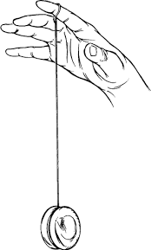
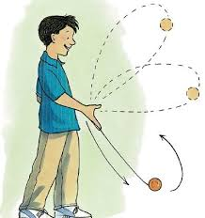
Calculus
A yo-yo moves straight up and down. Its height above the ground, as a function of time, is given by the function below, where t is in seconds and H(t) is in inches. At t = 0, it’s 30 inches above the ground, and after 4 seconds, it’s at height of 18 inches.

Slide 17
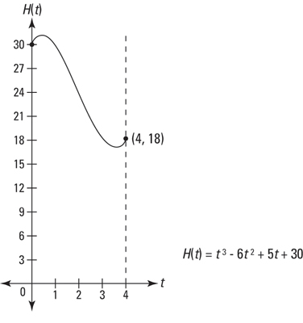
Calculus
A yo-yo moves straight up and down. Its height above the ground, as a function of time, is given by the function below, where t is in seconds and H(t) is in inches. At t = 0, it’s 30 inches above the ground, and after 4 seconds, it’s at height of 18 inches.

Slide 18
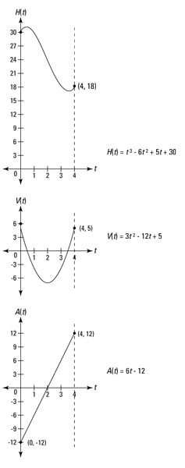
Calculus
Velocity, V(t) is the
derivative of position
(height, in this problem)
and acceleration, A(t), is
the derivative of velocity.
Thus
V(t)=3t²-12t+5

Slide 19
Calculus
acceleration, A(t), is
the derivative of velocity.
Thus
A(t)=6t-12

Slide 20
Calculus
Maximum and minimum height of H(t) occur at the local extrema you see in the above figure. To locate them, set the derivative of H(t) — that’s V(t) — equal to zero and solve.
These are the times when the yo-yo reaches its maximum and minimum heights. Plug these numbers into H(t) to obtain the heights:
H (0.47) ≈ 31.1
H (3.53) ≈ 16.9
So, the yo-yo gets as high as about 31.1 inches above the ground at t ≈ 0.47 seconds and as low as about 16.9 inches at t ≈ 3.53 seconds.

Slide 21
Calculus
Maximum and minimum velocity of the yo-yo during the interval from 0 to 4 seconds are determined with the derivative of V(t): Set the derivative of V(t) — that’s A(t) — equal to zero and solve:
V’(t)=A(t). Hence A(t)=6t-12, which when equated to zero, we obtain t=2.
Now, evaluate V(t) at the critical number, 2, and at the interval’s endpoints, 0 and 4:

Slide 22
Good morning

Slide 23
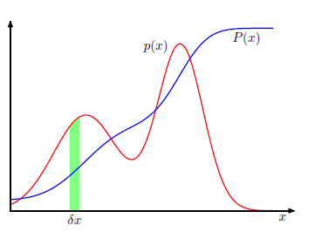
Probability
Approaches in probability
Baye’s Theorem
Random variable
Distribution/densities

Slide 24

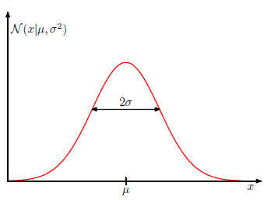

Gaussian Distribution
Normal

Slide 25
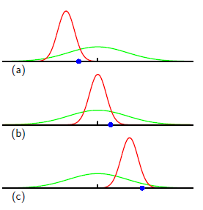
Gaussian Distribution
When we employ the method of maximum
likelihood, we may obtain errors
based on data .
Green is the true Gaussian and
the red ones are based on data in blue.

Slide 26
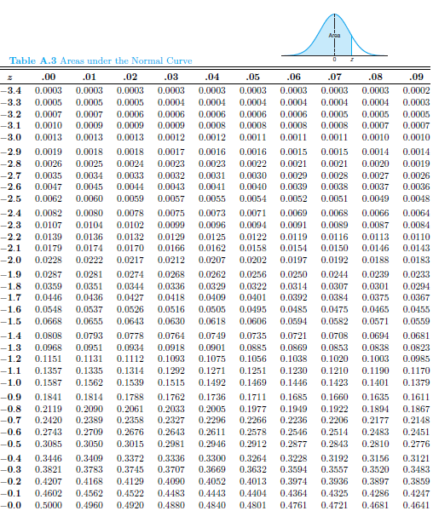
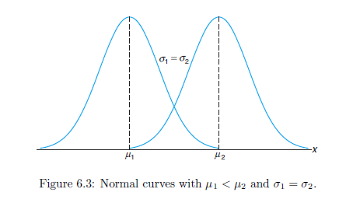
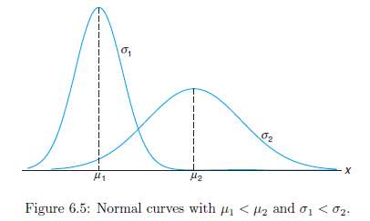
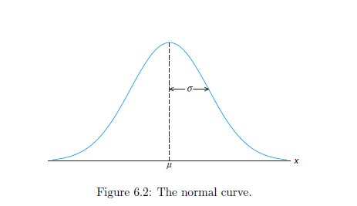
Gaussian Distribution
Gaussian/Normal.

Slide 27
Gaussian Distribution
Ex1: Suppose the diameter of a certain car component follows the normal distribution with X≈ N(10; 3). Find the proportion of these components that have diameter larger than 13.4 mm. Or, if we randomly select one of these components and the probability that its diameter will be larger than 13.4 mm.
Ex2: A bag of cookies is underweight if it weighs less than 500 grams. The filling process dispenses cookies with weight that follows the normal distribution with mean 510 grams and standard deviation 4 grams.
a. What is the probability that a randomly selected bag is underweight?
b. If you randomly select 5 bags, what is the probability that exactly 2 of them will be underweight?

Slide 28
Good morning

Slide 29
Decision theory
Broad types are
Normative and Descriptive:
A normative decision theory is a theory about how decisions should be made, and a descriptive theory is a theory about how decisions are actually made.
Decision process:
1.Identification of the problem
2. Obtaining necessary information
3. Production of possible solutions
4. Evaluation of such solutions
5. Selection of a strategy for performance

Slide 30
Decision theory
Suppose we have an input vector x together with a corresponding vector t of target variables, and our goal is to predict t given a new value for x.
From probability perspective, we are talking about the joint distribution p(x,t).
Determination of p(x, t) from a set of training data is inference.
Taking a specific action based on the predicted/expected values of t form Decision theory.

Slide 31
Good morning

Slide 32
Information theory
The theory studying information gathered from known values of random variables is information theory.
If X is a random variable with pmf p(x), then information is the quantity h(x) which is defined by Shannon as
h(x) =-log2p(x).
Low probability events x correspond to high information content.

Slide 33
Information theory
suppose that a sender wishes to transmit the value of a random variable to a receiver. The average amount of information that they transmit in the process is obtained by taking the expectation of with respect to the distribution p(x) and is given by
called the Entropy of the random variable X.
Consider a random variable x having 8 possible states, each of which is equally likely. In order to communicate the value of x to a receiver, we would need to transmit a message of length 3 bits. Notice that the entropy of this variable is given by
H(x)=-8*[1/8]*log2[1/8]= 3 bits.

Slide 34
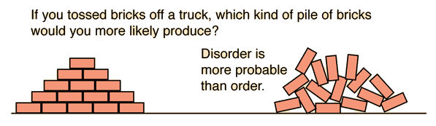
Information theory
A campfire is an example of entropy. The solid wood burns and becomes ash, smoke and gases, all of which spread energy outwards more easily than the solid fuel. Ice melting, salt or sugar dissolving, making popcorn and boiling water for tea are processes with increasing entropy in your kitchen.
Disorder is more probable than order

Slide 35
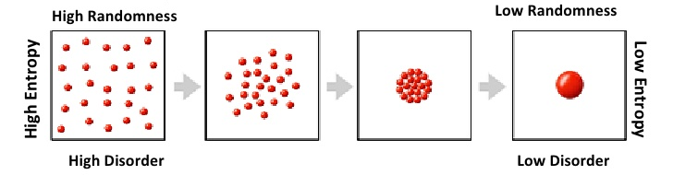
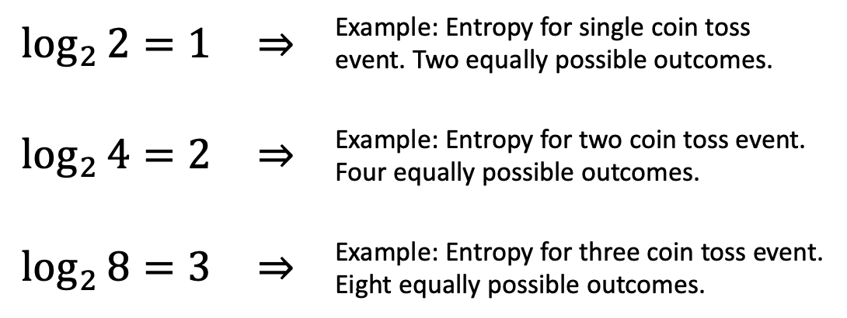
Information theory
Entropy: Degree of randomness. Lower the entropy, the more ordered and less random

Slide 36
Good morning

